Slide 1
Chapter 1
The HCS12/9S12 Microcontroller:
History and Features

Slide 2
Chapter Objectives
Upon completion you will be able to:
Compare and Contrast Microprocessors and Microcontrollers
Describe advantages of Microcontrollers for some applications
Explain the concept of embedded systems
Discuss criteria for considering a microcontroller
Explain the variations of speed, packaging, memory and cost per unit, and how these affect choosing a microcontroller
Explain the evolution of 68xx microcontrollers
Compare and contrast the various members of the HCS12 family
Give the history and features of HCS12/9CS12 microcontrollers

Slide 3
Section 1.1 Microcontrollers and Embedded Processors
What is the difference between Microcontrollers and General Purpose Microproccesors?
Example of general purpose microproccesor
Intel x86 – 8086,80286 to pentium
Motorola Power PC
Microprocessors require external resources such as
RAM, ROM, I/O, Timers
These are all included on a single chip in a Microcontroller

Slide 4
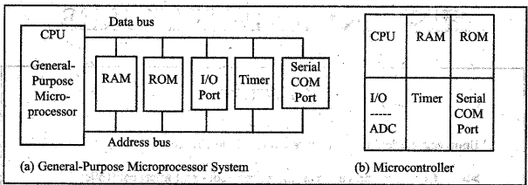
Microprocessor vs. Microcontroller

Slide 5
Microcontrollers for embedded systems
An embedded product is controlled by its own internal microprocessor or microcontroller as opposed to an external controller
In an embedded system, typically the microcontrollers ROM is burned with specific functions needed for the system
Consider a printer for example: The microcontroller for the printer mainly needs to get the data from the print server and print it.
As opposed a PC which can be used for any number of applications
Typically only one application software is burned into an embedded system
Some PC peripherals could contain embedded systems

Slide 6
In Class Exercise
Let’s brainstorm a list of products in our every day life that contain embedded systems.

Slide 7
Microprocessor Embedded Systems
Some times we need more computing power for high end embedded systems
We might consider
X86
Power PC
ARM
Single Chip Computer
X86 has advantage due to standardization of DOS, Windows and Linux
Shortened development time
Reduced cost

Slide 8
Choosing a Microcontroller
5 major options
Freescale 68HC08, 68HC11, 68HC12
Intel 8051
Atmel AVR
Zilog Z8
Microchip Technology PIC
Each option has unique instruction set and may have different bus structures 16 or 32 bit

Slide 9
Criterion for Application Choice
Meeting the computing need of the product requirements cost effectively
Availability of development tools
Wide availability and reliable sources for procurement

Slide 10
Meeting the Product Computing Need
8, 16, 32 bit architecture?
Speed (Clock Rate)
Packaging – DIP, QFP
Product process
Prototyping
Power Consumption
Memory Capacity – RAM, ROM
I/O pins and timer
Upgrade Path
Cost per unit

Slide 11
Development Tool Availability
Availability of
Assembler
Debugger
Code efficient C language compiler
Emulator
Tools
Technical Support
In house and External expertise

Slide 12
Supply Chain Issues
Availability of needed quantities now and in the future.
Product obsolesence
8051 has largest number of diversified suppliers, more than 50
Freescale, Atmel, Zilog and Microchip Technology have dedicated large support for their microcontrollers to ensure availability because they are mature, stable and single source
FPGA chips and ASIC libraries are available to support these microcontrollers

Slide 13
Mechatronics and Microcontrollers
Microcontrollers are playing an increasing role
Mechatronics is about integration of mechanics, electronics and information processing
Mechatronics requires multidisciplinary expertise across disciplines such as mechanical engineering, electronics, information technology, and decision making theories

